Slide 1
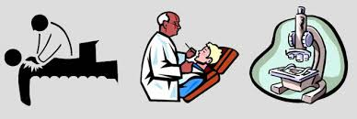
Diagnostic Research
Picture diagnostic research

Slide 2

Notes:
A woman enters your primary care clinic with her baby daughter of 6 months. Over the last couple of weeks, she’s developed a rash on her arms and seems to have been suffering from belly cramps now and again. Her mother suspects it might have started because she recently introduced cow milk into her daughter’s diet

Slide 3

Notes:
One option would be to refer your patient to an allergy specialist for an oral food dechallenge-rechallenge test, which may give you conclusive evidence. Alternatively, you could decide to do the test yourself. During such a test cow milk is first removed from the baby’s diet and then carefully reintroduced while closely monitoring the symptoms. Anyway, this kind of testing requires weeks and is quite burdening, so you’d rather not use it unless absolutely necessary.
On the other hand, you don’t want to diagnose the baby with having cow milk allergy, and consequently adapt her diet, unless you’re confident enough about the presence of the disease.

Slide 4
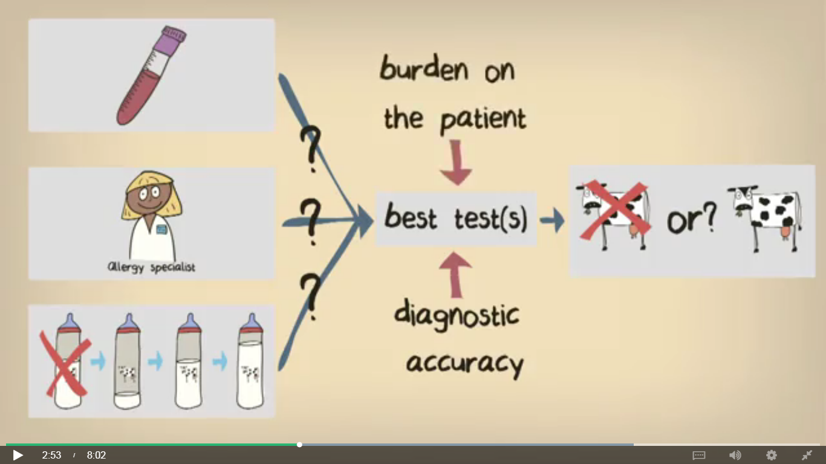

Slide 5
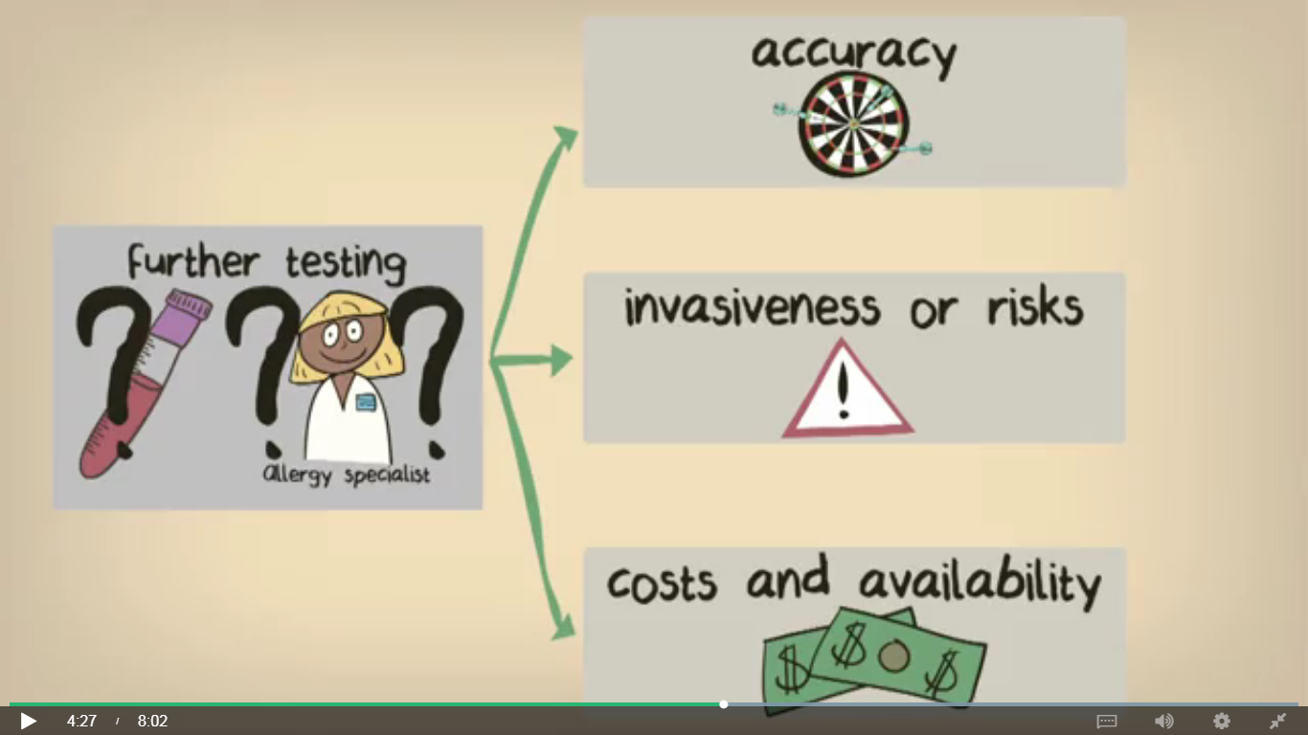

Slide 6
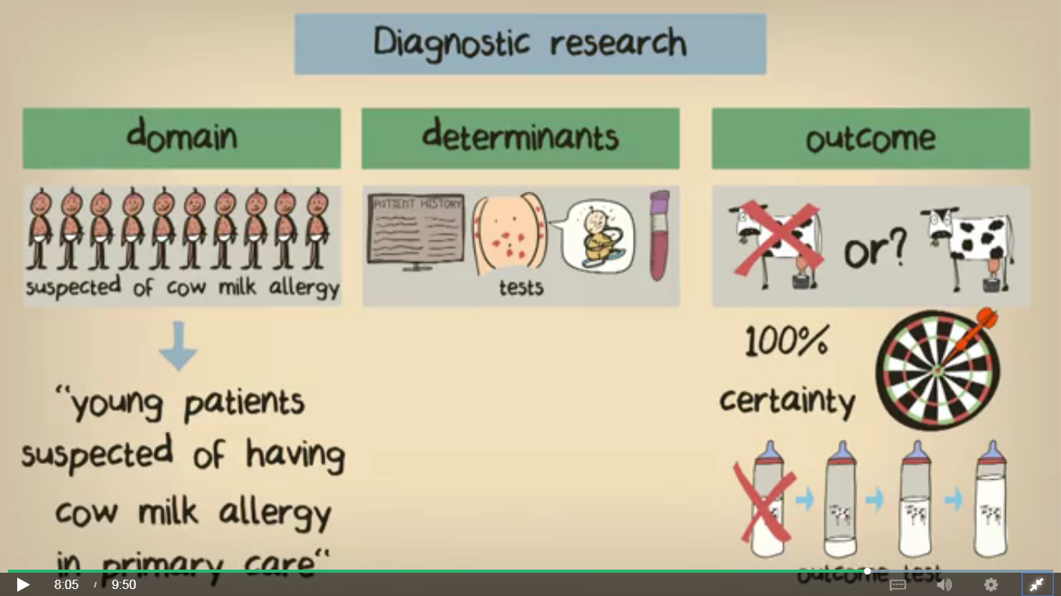

Slide 7
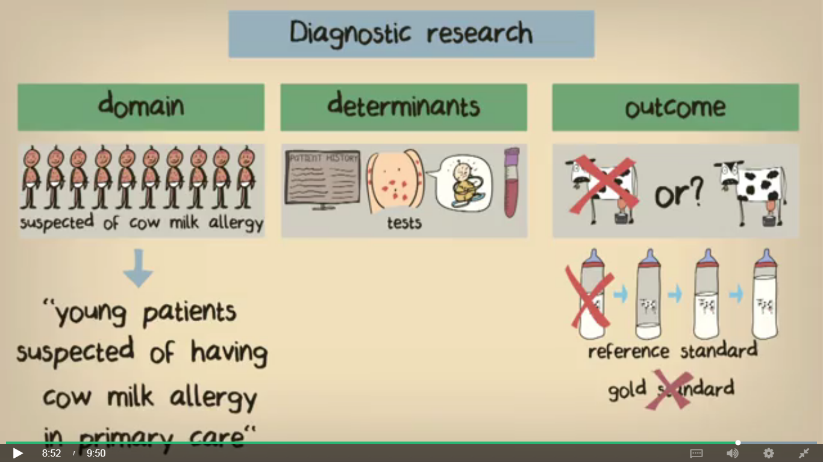
Notes:
Diagnosis of cow milk allergy starting from a primary care setting is quite different to diagnosis within a specialist setting, such as an allergy clinic. We were originally interested in diagnosing or excluding the diagnosis in primary care, and so this could also be part of the definition of our domain
we have to do our very best to assess whether the children actually have an allergy to cow milk or not. Ideally we should know this with absolute certainty so that we can assess the accuracy of the diagnostic tests we’re interested in. The “gold standard” test for assessing cow milk allergy is an oral food challenge test, and it’s seen as a means of reaching a definitive conclusion. Therefore we can use this test to determine the outcome.
But is measuring the outcome really that straightforward? Depending on how invasive and risky such a “gold standard” really is, it could be considered unethical to perform it in every individual in our study. And what about research problems where there’s no such perfect test? It may be the case in diagnostic research that we’re interested in finding an accurate combination of tests because there’s no clear way to reach a conclusive diagnosis. For this reason, in diagnostic research, it’s common to use the term “reference standard” instead of “gold standard” when discussing the outcome measure, because for most diagnoses there’s no “gold standard”.
In oncologic diagnostics, the typical example is to verify each result of a diagnostic examination for a sample of n patients with the pathology report.

Slide 8


Compare to reference
TRUE / FALSE
POSITIVE/ NEGATIVE
Notes:
. It will be true positive when the radiologist has correctly defined a pathologically proven malignant lesion as positive, true negative when the radiologist has correctly defined a non-malignant finding as negative, false positive when the radiologist has incorrectly defined a non-malignant finding as positive, and false negative when the radiologist has incorrectly defined a malignant lesion as negative.
Same patient same lesion
The initial studies on
the diagnostic performance of a new imaging modality or technique benefit greatly
from the reporting of indices on a lesion-by-lesion basis: we can have a small
number of patients and obtain a measure of what happens for each of the lesions.
Afterwards, more conclusive information on the value of the clinical application
of a new modality or technique can be obtained with a patient-by-patient analysis.
In the latter situation, we sometimes have to solve relevant conceptual problems
(implying the clinical relevance of radiologic findings) for the definition of
true positive, false positive, true negative, and false negative patient when multiple
lesions are present and lobes, segments or organs are affected by the disease.

Slide 9
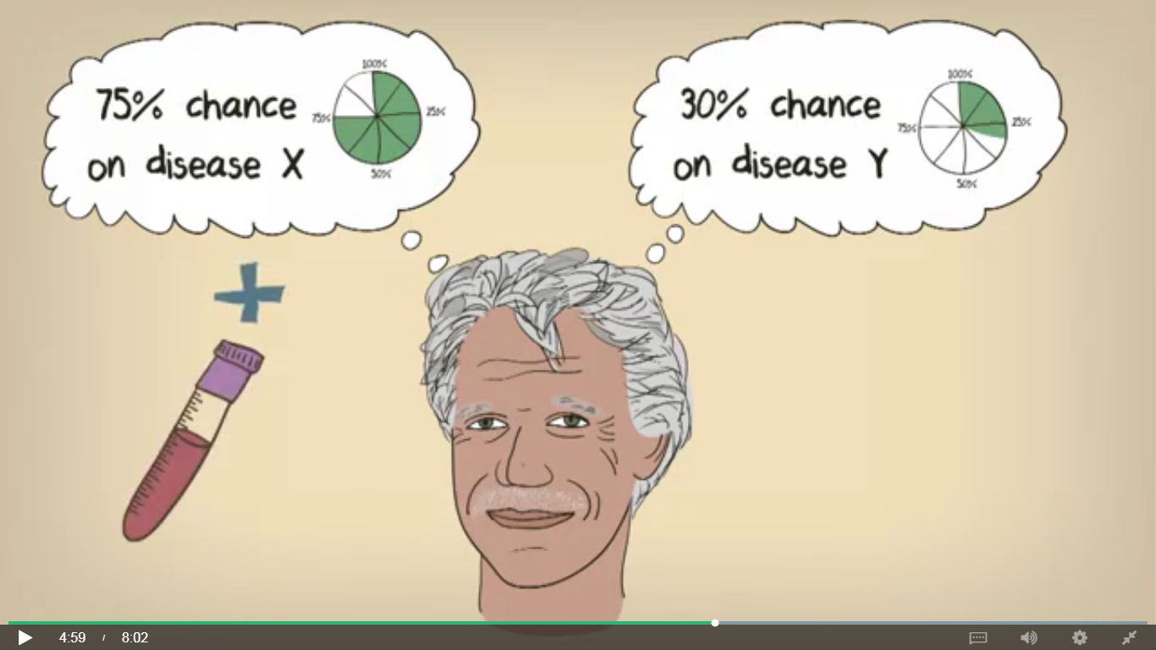

Slide 10
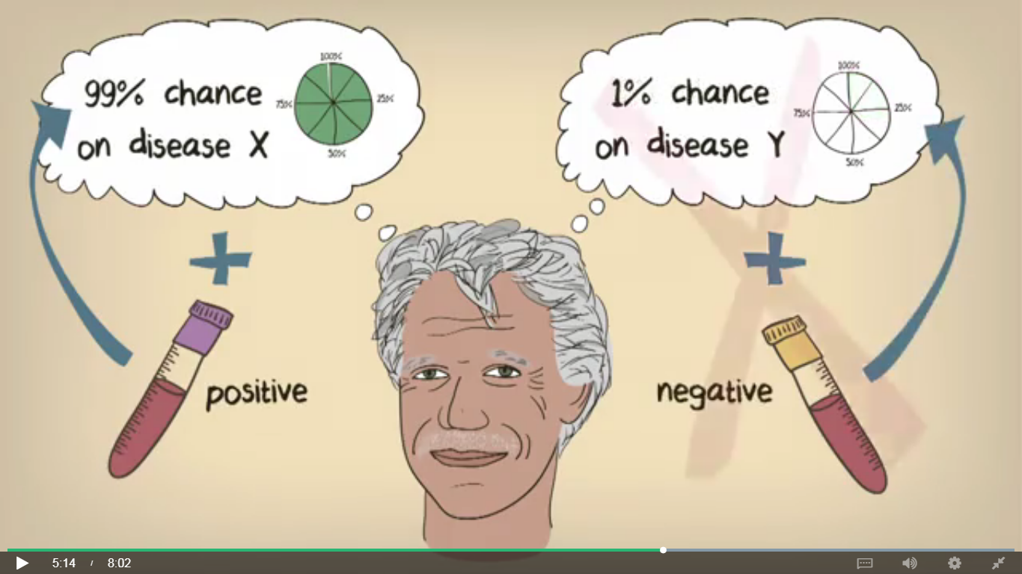

Slide 11
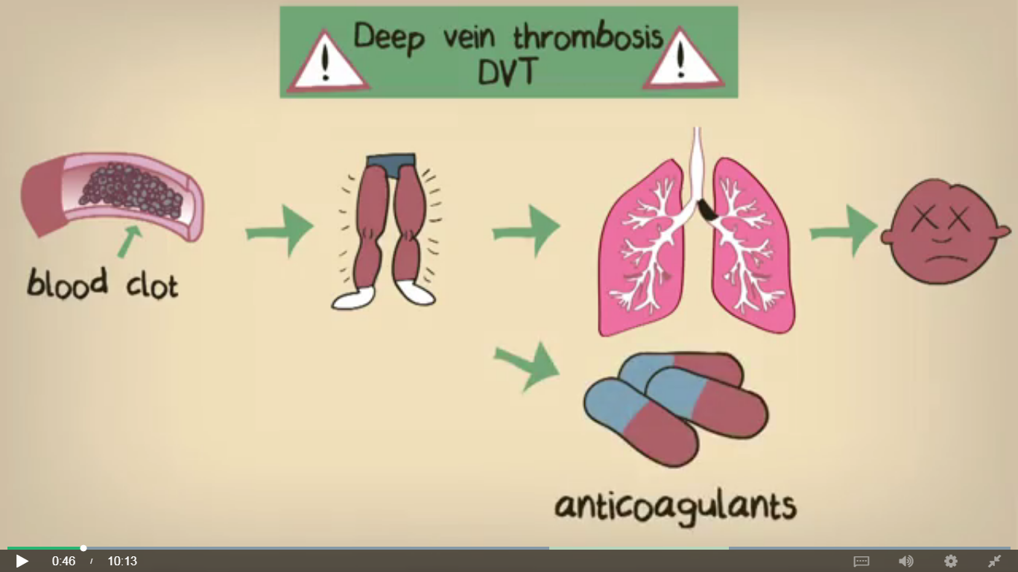

Slide 12
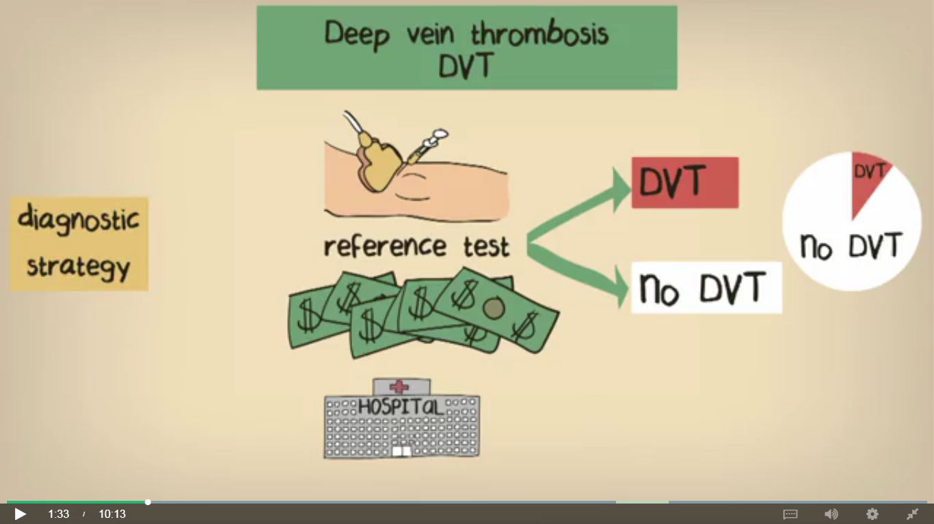

Slide 13
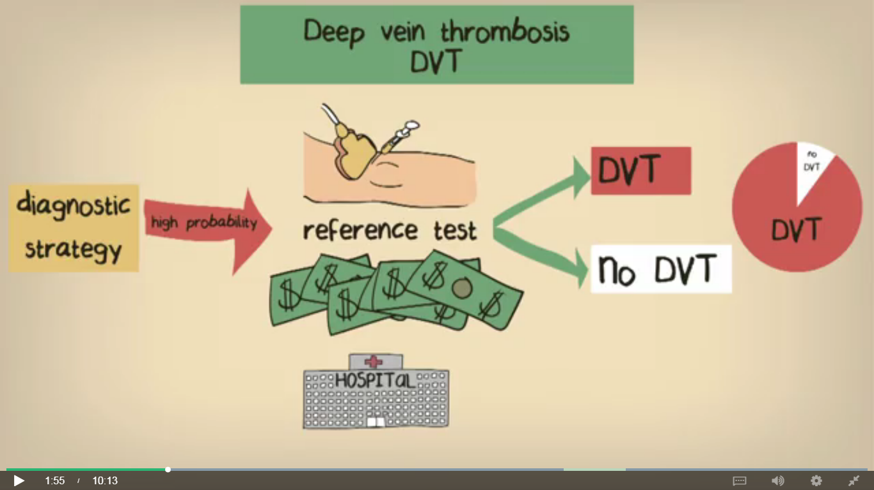

Slide 14
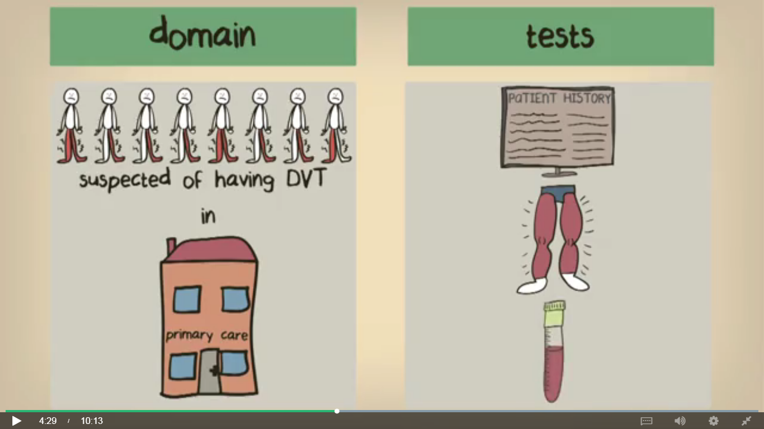

Slide 15
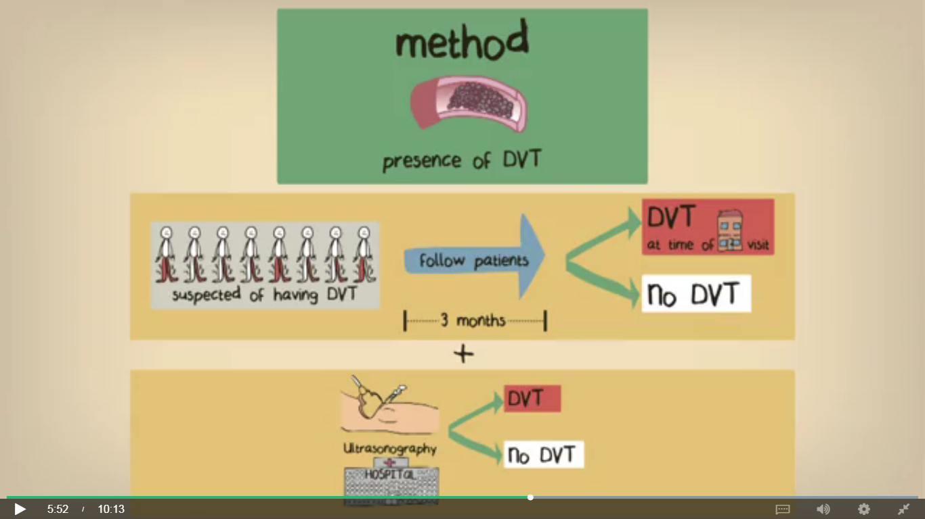

Slide 16
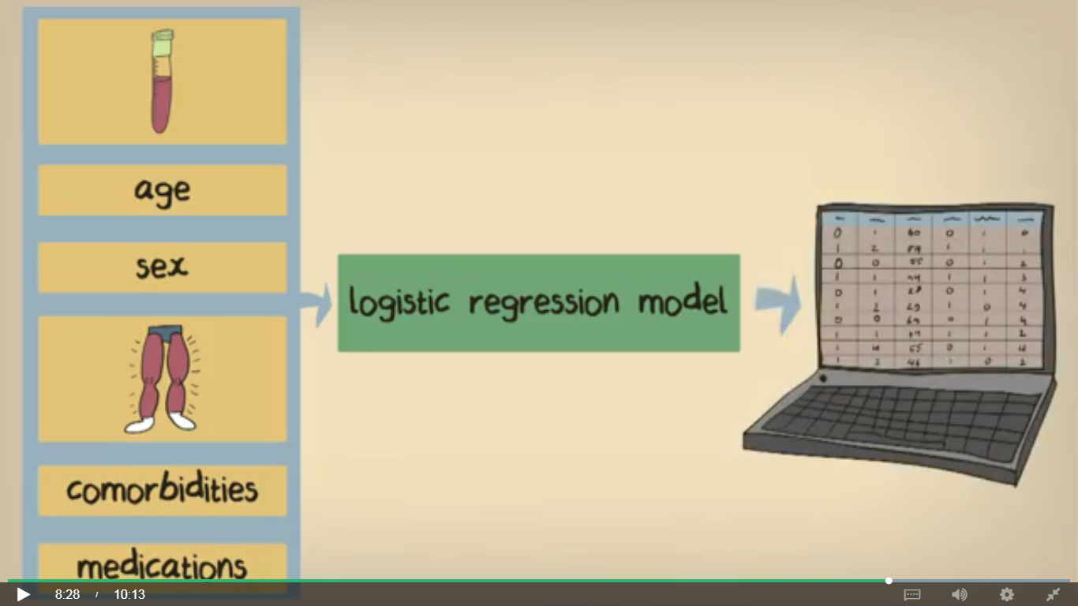

Slide 17
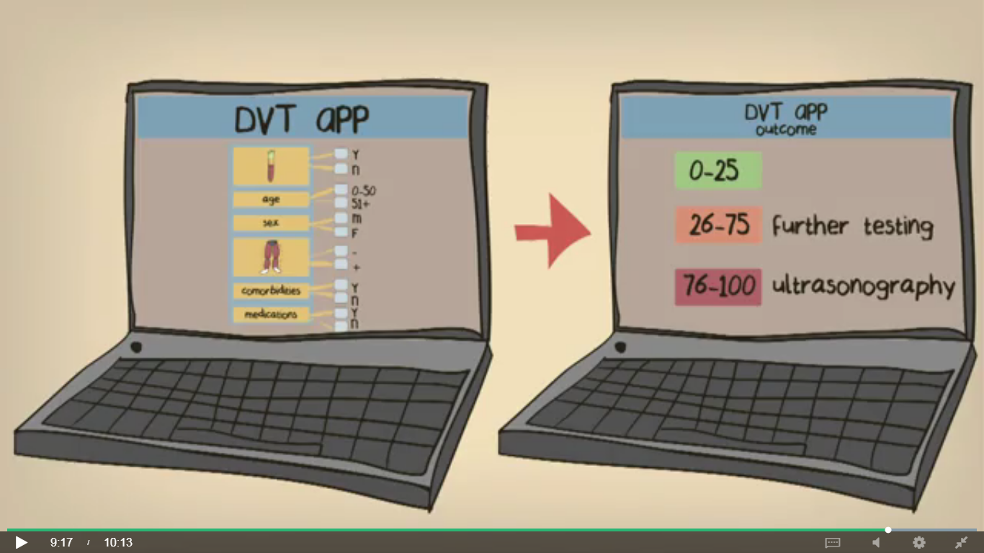

Slide 18
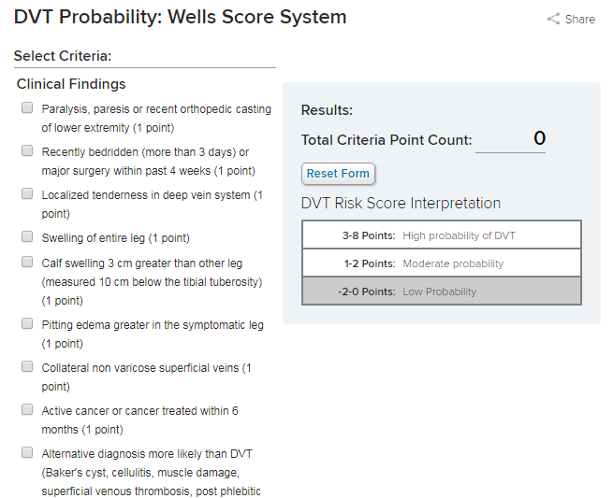

Slide 19
Don’t stop with an answer [...]
An answer is always the stretch of road that’s behind you.
Only a question can point the way forward.

Slide 20
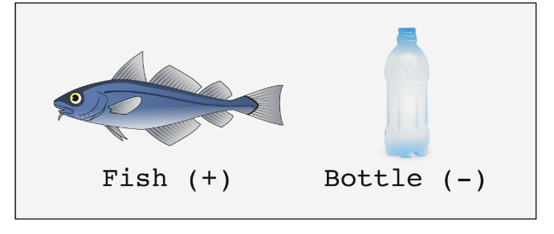

Slide 21
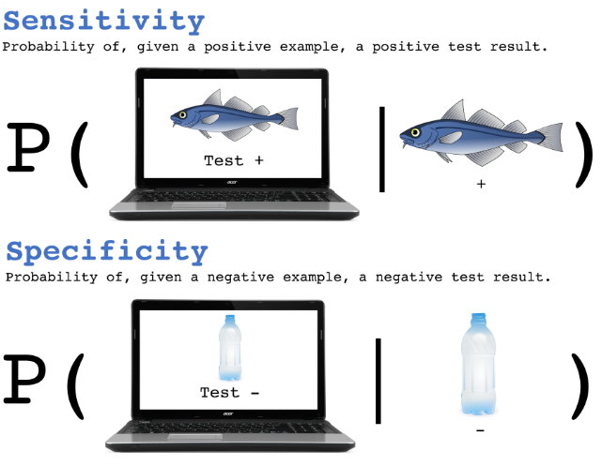

Slide 22


Slide 23
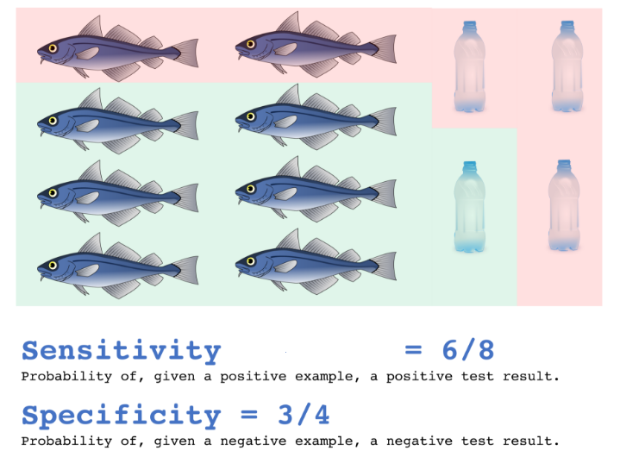
Notes:
Sensitivity= Probability that, if you truly have the disease, the diagnostic test will catch it.
Specificity=Probability that, if you truly do not have the disease, the test will register negative.
PPV = the probability that if you test positive for the disease, you actually have the disease.
NPV = the probability that if you test negative for a disease, you actually do not have the disease.
Depends on the characteristics of the test (sensitivity, specificity) and the prevalence of disease.

Slide 25
Notes:
The first seven indices range between 0 and 1 and frequently are reported as percentages. The first five indices indicate an increasingly high diagnostic performance of the examination under investigation the closer they are to 1.
The meaning of the last two indices, i.e. the likelihood ratios (LRs), is a bit more complex. They theoretically range between 0 and infinity but practically indicate an increasingly high diagnostic performance the further they move away from 1, with the positive LR moving towards values higher than 1 and the negative LR towards values lower than 1

Slide 26

Test positive….hmmmmmmmm
what is the probability that I have the disease?

Slide 27

Will the test be able to predict the disease?

Slide 28

Notes:
The differentiation between sensitivity and specificity as answers to pre-examination questions on
the one hand and predictive values as answers to post-examination questions on the other hand
underlines the different logic of these indices of diagnostic performance.

Slide 29

Notes:
Limitation:
Likelihood ratio

Slide 30

Which house

Slide 31

Notes:
Taba5 rezel, lw 2al marra amen, 5alas

Slide 32

All have the disease
Sensitivity 1% Specificity 99%
PPV ?? NPV ??
Notes:
if all the sample subjects have the disease, , the positive predictive value is always
1.0 (i.e. 100%) even with very low sensitivity (but not 0) and the negative predictive
value is always 0.0 (i.e. 0%) even with very high specificity (even equal to
1.0, i.e. 100%).

Slide 33

Sensitivity 1% Specificity 99.9%
PPV ?? NPV ??
Notes:
, if all the sample subjects do not have the disease, the
negative predictive value is always 1.0 (i.e. 100%) even with very low sensitivity
(but not 0) and the positive predictive value is always 0.0 (i.e. 0%) even with very
high specificity (even equal to 1.0, i.e. 100%).

Slide 34
scenario
Imagine 10,000 women with a palpable lump are studied (clinical mammography), with 95% sensitivity and 80% specificity. With a disease prevalence of 50%, we would have 4,750 true positives, 4,000 true negatives, 1,000 false positives, and 250 false negatives. The PPV would be 4,750/(4,750+1,000) = 0.826 = 82.6%; the NPV 4,000/(4,000+250) = 0.941 = 94.1%.
What is the number of healthy women among those checked?
Notes:
For nearly every 5 women affected with cancer there would be a healthy woman who undergoes diagnostic work-up with possible needle biopsy (4,750/1000 = 4.75).

Slide 35
However, if we were to study 10,000 asymptomatic women (screening mammography) with the same levels of sensitivity and specificity (95% and 80%, respectively) with a disease prevalence of 3%, we would have 285 true positives, 7,760 true negatives, 1,940 false positives, and 15 false negatives. The NPV would go up to 7,760/(7,760+15) = 0.998 = 99.8%, PPV would go down to 285/(285+1,940) = 0.128 = 12.8%.
What is the number of healthy women among those checked?
Notes:
This means that nearly 7 healthy women would be sent for diagnostic work-up with a possible needle biopsy for every woman effectively diagnosed with cancer (1,940/285 = 6.8).
Above all, the women would
lose confidence with the screening program

Slide 37
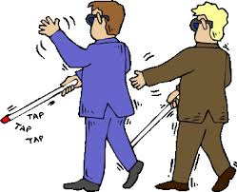
Sensitivity/specificity can’t really see
Notes:
While the predictive values are clearly related to a defined disease (“predictive
of … malignant tumor”), sensitivity and specificity may appear to be
properties intrinsic to the examination and independent of the disease we
would like to confirm or to exclude
. Sensitivity and
specificity of a radiologic examination do not depend on disease prevalence.
However, they must be related to a defined disease. Unfortunately, this relation
is frequently omitted or considered implicit.

Slide 38
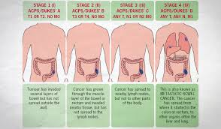

Notes:
In this way we observe a direct influence on sensitivity
and specificity: they are higher in symptomatic subjects than in asymptomatic
subjects in whom the disease is more likely in an early stage. This difference is
lower at the first round of an oncologic screening program (when we detect the
prevalent tumors, with numerous cases which could have been diagnosed even in
an earlier stage) and is higher in the later rounds (when we detect the incident
tumors, not present at the first round).

Slide 39

clinical radiology and screening radiology
Trading off sensitivity and specificity

Slide 40


Clinical Radiology
Notes:
we should try to
use examinations with a high sensitivity, even in the presence of a relatively low
specificity (this drawback will be compensated for in the following steps of the
diagnostic algorithm)

Slide 41

Screening
Notes:
In clinical radiology, we emphasize even minimal signs as suspicious
of disease (especially if related to symptoms), postponing the ultimate
diagnosis to the later steps. In screening radiology, we can ignore the minimal
signs in order to avoid too high a recall rate.

Slide 43
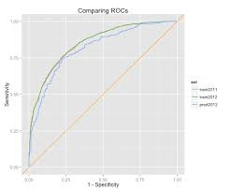
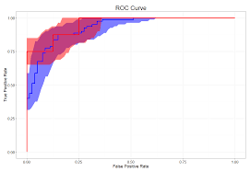
ROC
Notes:
sensitivity is graphed on the y-axis and 1 – specificity on the x-axis
ROC
curves were introduced to optimize the signal detection after the Japanese
attack on Pearl Harbor, in order to understand why the radar receiver operators
failed to identify Japanese warplanes. Since the 1950s, ROC curves have been
used in psychophysiology and have entered the field of statistical methods.

Slide 44
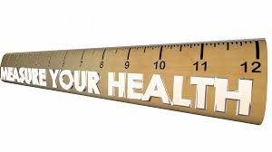
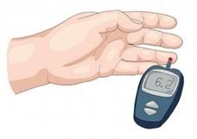

Slide 45
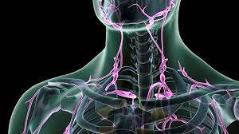
Notes:
A typical example is the diagnosis of metastatic mediastinal lymph nodes on
CT scans on the basis of their size measured as maximal diameter. If we use the
classic cutoff which defines nodes larger than 10 mm in diameter as metastatic,
we cannot avoid either a fraction of false negatives (metastatic nodes small er than or equal to 10 mm in diameter) or a fraction of false positives (nonmetastatic
nodes larger than 10 mm in diameter). By lowering the cutoff we
increase sensitivity but reduce specificity, whereas by increasing the cutoff we
increase specificity but reduce sensitivity.

Slide 46

Notes:
The cutoff could be optimized by choosing the level which minimizes total
errors (the sum of false negatives and false positives). However, in clinical
practice we adjust – often unconsciously – the cutoff to distinguish normal
from abnormal findings in relation to the clinical history and the results of previous
examinations which determine the pretest disease probability. For
instance, a history of previous malignancy will prompt the adoption of a lower
cutoff for the size of a mediastinal node considered suspicious of metastasis.
The presence of a deleterious mutation of BRCA1 or BRCA2 genes in women,
a relevant family history of breast or ovarian cancer, or the simple personal history
of previous breast cancer in the patient prompts the adoption of a lower
cutoff reading for the mammography or MR breast examination. In this way a
radiologist unconsciously uses Bayes’ theorem, increasing sensitivity (and
probably losing specificity

Slide 47

ROC application
0.90-1 = excellent (A), 0.80-0.90 = good (B); 0.70-0.80 = fair (C); 0.60-0.70 = poor (D); 0.50-0.60 = fail (F).
Notes:
A relevant application of the ROC curve in radiology, in the setting of the
diagnosis of a defined disease, is the comparison between different imaging
modalities or different approaches (e.g. new or old techniques), or different
readers

Slide 48
ROC curve app
https://sachsmc.shinyapps.io/plotROC/

Slide 49


Slide 50
Under what circumstance would you really want to minimize the false positives?
Notes:
Minimizing false positives is important when the costs or risks of followup therapy are high and the disease itself is not life-threatening...prostate cancer in elderly men is one example; as another, obstetricians must consider the potential harm from a false positive maternal serum AFP test (which may be followed up with amniocentesis, ultrasonography and increased fetal surveillance as well as producing anxiety for the parents and labeling of the unborn child), against potential benefit.

Slide 51
When would you want to minimize the false negatives?
Notes:
We don’t want many false negative if the disease is often asymptomatic and
is serious, progresses quickly and can be treated more effectively at early stages OR
easily spreads from one person to another

Slide 52

Fun example
“A patient who tests positive has approximately a 70% chance of developing moderate to severe cellulite.” (PPV)
“A patient who tests negative has approximately a 50% chance of not developing moderate to severe cellulite.” (NPV)

Slide 53
CelluliteDX Data
Researchers compared the ACE genotype of 200 women with moderate to severe cellulite (cases) and 200 cellulite-free controls.
They found that a significantly higher proportion of cases carried at least one D allele.
Cellulite
ACE genotype
+
-
DD/DI
168
148
316
II
32
52
84
200
200

Slide 54
Sensitivity and Specificity
Cellulite
Cellulite DX Test
+
-
+
168
148
316
-
32
52
84
200
200
Sensitivity=168/200=.84
32 false negatives out of 200 cases
Specificity= 52/200 =.26
148 false positives out of 200 controls

Slide 55
What is the positive predictive value? Tricky!
Cellulite
Cellulite DX Test
+
-
+
168
148
316
-
32
52
84
200
200
PPV and NPV cannot be calculated directly because the prevalence of cellulite in the sample differs from the prevalence in the general population.

Slide 56
Alternatively, calculate with a simple 2x2 table:
Cellulite
Cellulite DX Test
+
-
+
-
65
35
100
To solve for PPV and NPV, must incorporate the true prevalence. Trick: start with 100 people…

Slide 57
PPV and NPV calculation
Cellulite
Cellulite DX Test
+
-
+
55
-
9
65
35
100
Then apply sensitivity and specificity….
True positives=65*.84= 55
True negatives = 35*.26= 9

Slide 58
PPV and NPV calculation
Cellulite
Cellulite DX Test
+
-
+
55
26
81
-
10
9
19
65
35
100
Then apply sensitivity and specificity….
True positives=65*.84= 55
True negatives = 35*.26= 9

Slide 59
PPV and NPV calculation
Cellulite
Cellulite DX Test
+
-
+
55
26
81
-
10
9
19
65
35
100
PPV=55/81=68%
68% of those who test positive will get cellulite.
NPV=9/19=47%
47% of those who test negative will NOT get cellulite. I.e, 53% will get cellulite.

Slide 60
Conclusions
A patient who does not take the test has a 65% chance of getting moderate to severe cellulite (=the prevalence of the disease in the general population)
Four out of five women will test positive. A positive test moves a woman’s risk from 65% to 68%.
One out of five women will test negative. A negative tests moves a woman’s risk from 65% to 53%.
Notes:
Conclusion: the test is basically useless.

Slide 61
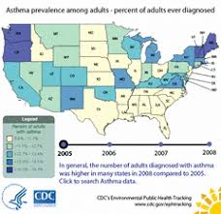

Conclusions
Notes:
Sensitivity and specificity do not depend on the prevalence of disease.
PPV and NPV (what patients care about!) depend on the prevalence of disease.
Just because a risk factor is significantly associated with a disease does not make it a useful screening test!

Slide 62

Notes:
quantify the ability of a diagnostic examination to change the disease probability

Slide 63


Notes:
As an example, imagine a positive pregnancy test on a man. This will certainly be a wrong result, and the context of the test (the zero probability of a man being pregnant) was more helpful than the test itself. This is the essence of Bayes’ Theorem: the pre-test probability of zero was critical in understanding how to interpret the result. For a second example imagine a 19-year old girl who has a ‘positive’ stress test. This is much like the man tested for pregnancy. A teenager has a virtually zero chance of significant coronary artery disease, but might well have a ‘positive’ stress test. Now imagine a 65-year old diabetic man who smokes and has been having chest pain with exertion. His positive stress test is quite likely to be correct. This is because his pre-test probability of disease was in the range of 50%. After a positive stress test his probability moves to roughly 80% or more—a number we can determine by mathematically applying LRs to the pre-test probabiliy.

Slide 64
Elevated osmolar gap had a sensitivity of 90% and a specificity of 22% (it can be elevated due to a panoply of substances). So, it's probably a reasonable screening test to rule-out toxic alcohol ingestion, but not as a diagnostic test to rule-in toxic alcohol ingestion.

Slide 65
Wrong. Based on 90% sensitivity and 22% specificity, the test has a positive likelihood ratio (+LR) of 1.15 and a negative likelihood ratio (-LR) of 0.45. These are weak likelihood ratios, of little help clinically.
For example, suppose that we're trying to use osmolar gap to exclude toxic alcohol ingestion in a patient with a 10% pre-test probability. If the osmolar gap is normal, then the post-test probability decreases to 5%, which doesn't really rule this out.

Slide 67
Key references
utrecht university clinical epidemiology course
Statistics in medicine. Stanford university
Biostatistics for Radiologists, Giovanni di Leo, Springer, 2009

